Slide 1




Heart Disease Prediction Using Logistic Regression
Presented By: Prerana Roy

Slide 2
Project Aim & Problem Statement
Aim: The aim of this project is to predict whether a patient has heart disease using Logistic Regression.
Problem Statement:
Heart disease is a major global health concern requiring early detection.
The dataset includes key medical and lifestyle features such as Age, Gender, Cholesterol, Diabetes, Smoking, Family History, Obesity, Chest Pain Type, Exercise Hours, and more.
The goal is to analyze these factors and train a Logistic Regression model to classify patients into Heart Disease or No Heart Disease.
This helps demonstrate how machine learning can support medical decision-making and risk assessment.

Slide 3
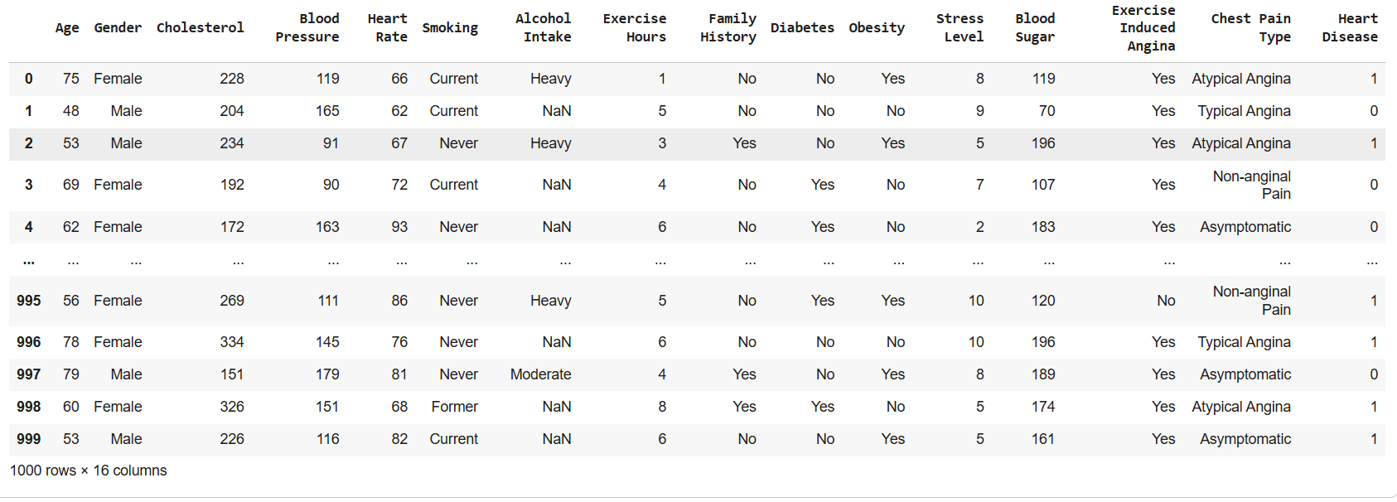
Dataset Description
The dataset contains patient health and lifestyle records used to analyze heart disease risk.
Key attributes in the dataset:
Target Column:
Heart Disease : 1 = Disease present, 0 = No disease

Slide 4
Data Preprocessing Steps
Check Missing Values
to identify null or invalid entries
Load Dataset
Encode Categorical Columns
Converted all categorical columns into numeric
Split data into 80% training and 20% testing using train_test_split().
Prepared Features and Target
X = all columns except 'Heart Disease'
y = 'Heart Disease'
Fix Invalid Values and Dropped rows containing NaN values using df.dropna().

Slide 5
Model Creation
Make Predictions
Generated predictions on test data using model.predict(X_test)
Select Model
Used LogisticRegression() for binary classification (Disease / No Disease).
Train the Model
Fitted the model using model.fit(X_train, y_train).
Compare Predicted vs Actual
Printed actual values and predicted values to observe performance.
Evaluate Model Performance
Calculated accuracy using accuracy_score(y_test, y_predict).

Slide 6
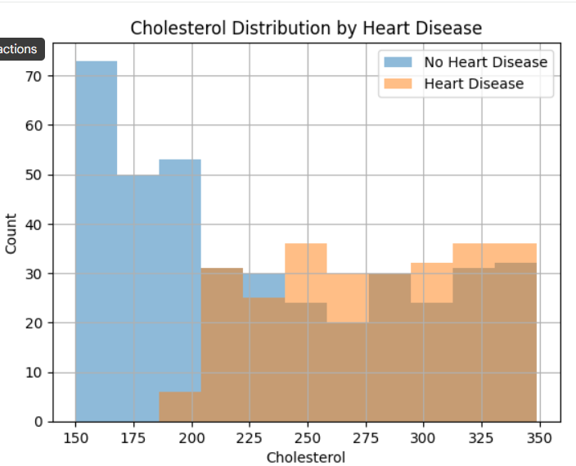
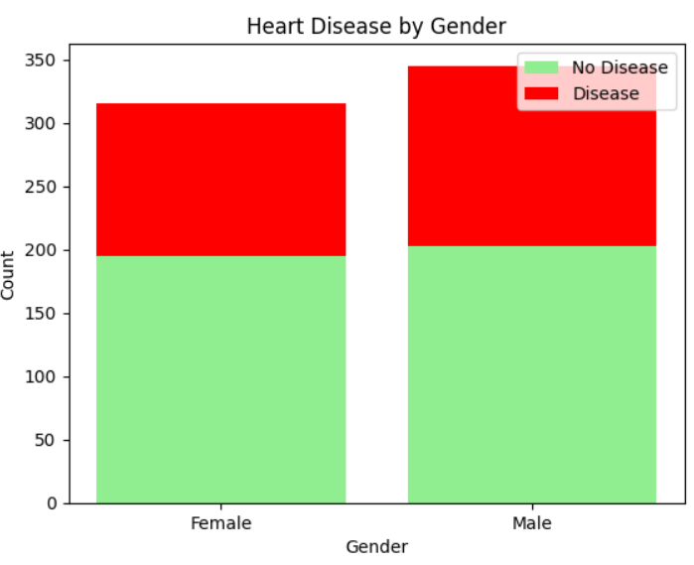
Graphs / Visualizations
Histogram — Cholesterol Distribution
Compares cholesterol levels for Disease vs No Disease groups.
Useful for observing if high cholesterol is linked to heart disease.
Bar Chart — Heart Disease by Gender
Shows the number of male and female patients with and without heart disease.
Helps understand gender-based risk differences

Slide 7
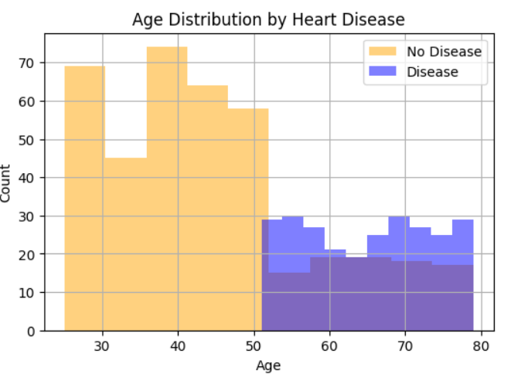
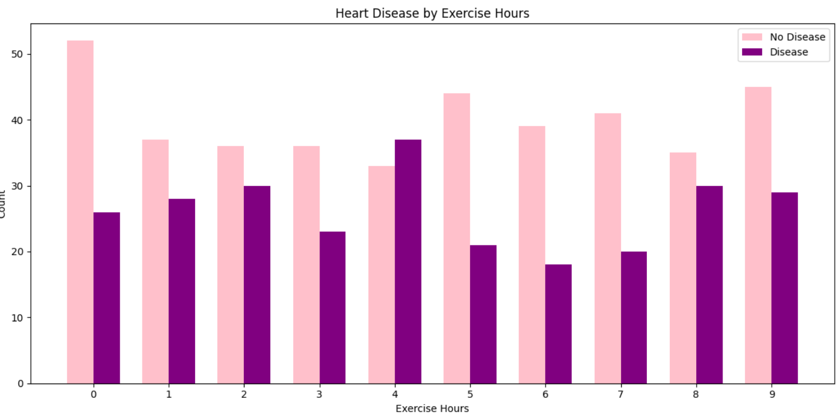
Graphs / Visualizations
Histogram — Age Distribution
Displays age ranges for both categories.
Helps see which age groups are more affected.
Bar Chart — Exercise Hours vs Heart Disease
Shows how physical activity relates to disease presence.
Reveals whether lower exercise hours correlate with higher disease risk.

Slide 8
Conclusion
Successful Prediction Model
Logistic Regression effectively classified patients into Heart Disease / No Heart Disease categories.
Key Observations
Age and cholesterol levels show strong relationships with heart disease.
Exercise hours and lifestyle habits also influence risk.
Visualizations helped uncover meaningful patterns in the dataset.
Overall Outcome
This project demonstrates how machine learning can support early detection and risk assessment for heart disease.

Slide 9
Thank You…

